Slide 1
PYTHON DOCSTRING GENERATOR
PRESENTED BY:
P SRAVANI NAGA MAHA LAKSHMI

Slide 2
agenda
Project overview
Architecture
Technologies used
Methodologies
Implementation Details

Slide 3
Project overview
Automates Python docstring generation
Built with Flask and Google Gemini AI (v2.5)
Upload .py files → detects functions
Shows existing docstrings or generates new ones
Supports multiple styles: Google, NumPy, PEP257, Sphinx
Download the file generated

Slide 4
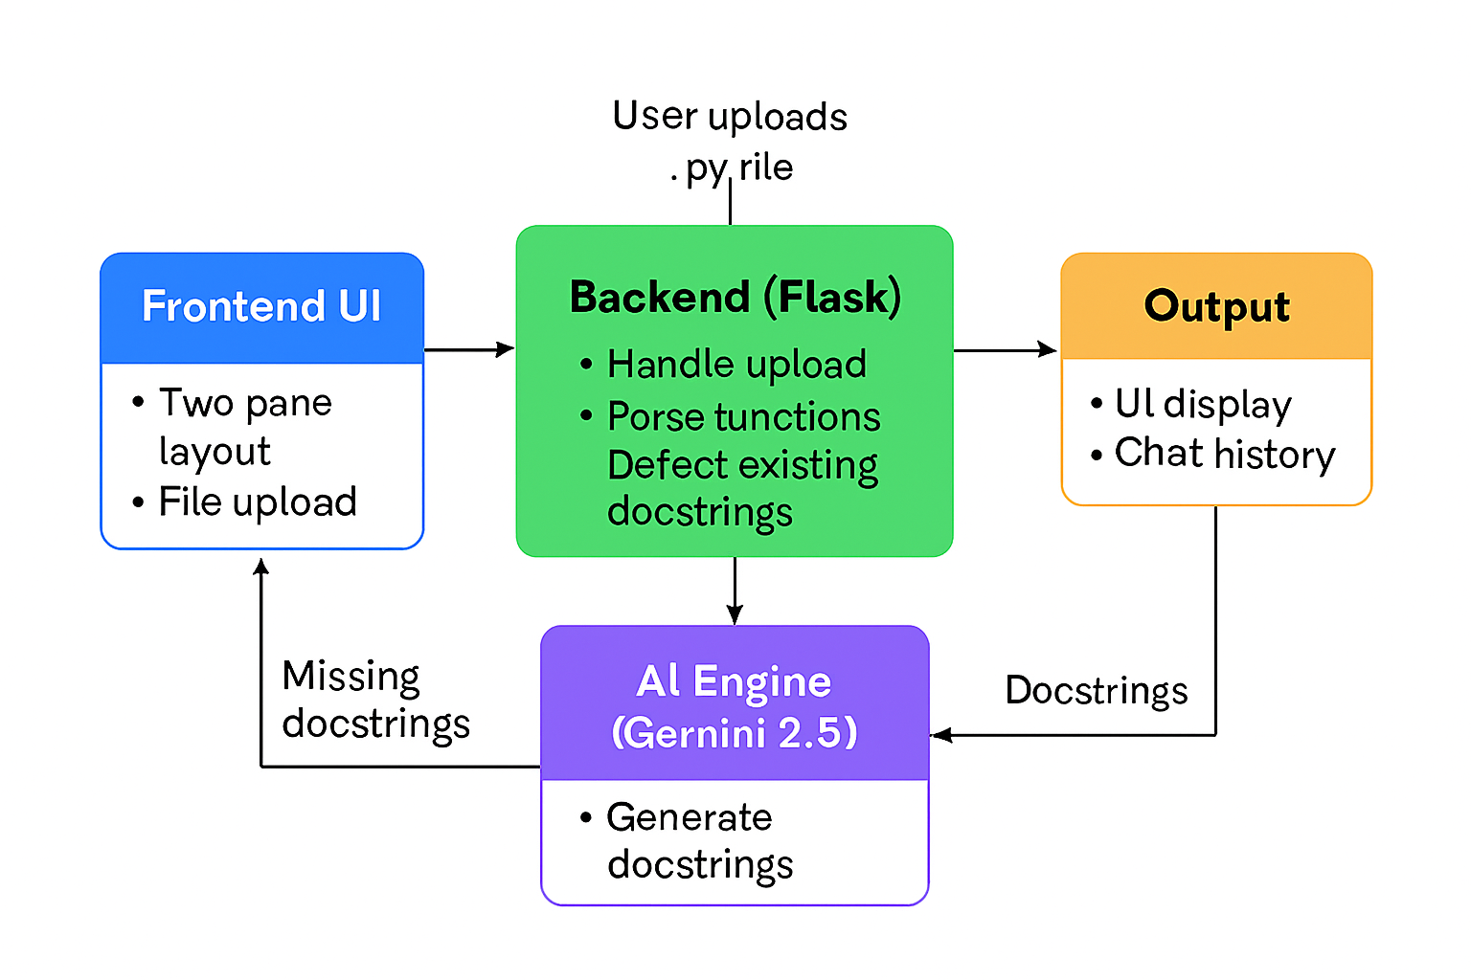
architecture
Frontend: HTML, CSS (two‑panel layout)
Backend: Flask routes handle uploads & API calls
Parser: Python ast module extracts functions/docstrings
AI Engine: Gemini 2.5 generates missing docstrings
Output: Results displayed in UI + stored in history

Slide 5
Technologies Used
Python 3.10+
Flask :used for web Framework
Google Gemini AI v2.5 (docstring generation)
AST module (code parsing)
HTML/CSS (frontend UI)

Slide 6
Methodology
User uploads Python file
Flask reads and parses file with ast
For each function:
  If docstring exists → display function + docstring
  If missing → send function code to Gemini 2.5
AI returns standardized docstring in chosen style
Results shown in UI and saved in history

Slide 7
Implementation details
UI: Split panels → left (history), right (upload + output)
Backend: Flask route / handles GET/POST requests
Gemini API: Generative Model("gemini-2.5") used for generation
Output Formatting: Function name + docstring displayed neatly
Deployment: Runs locally with Flask, can be extended to cloud

Slide 8
Thank you

